Slide 1

glassAI
Artificial Intelligence for the Future of Glass
Revolutionizing sales, production, and installs in the glass industry.
By Benjamin Lebron

Slide 2
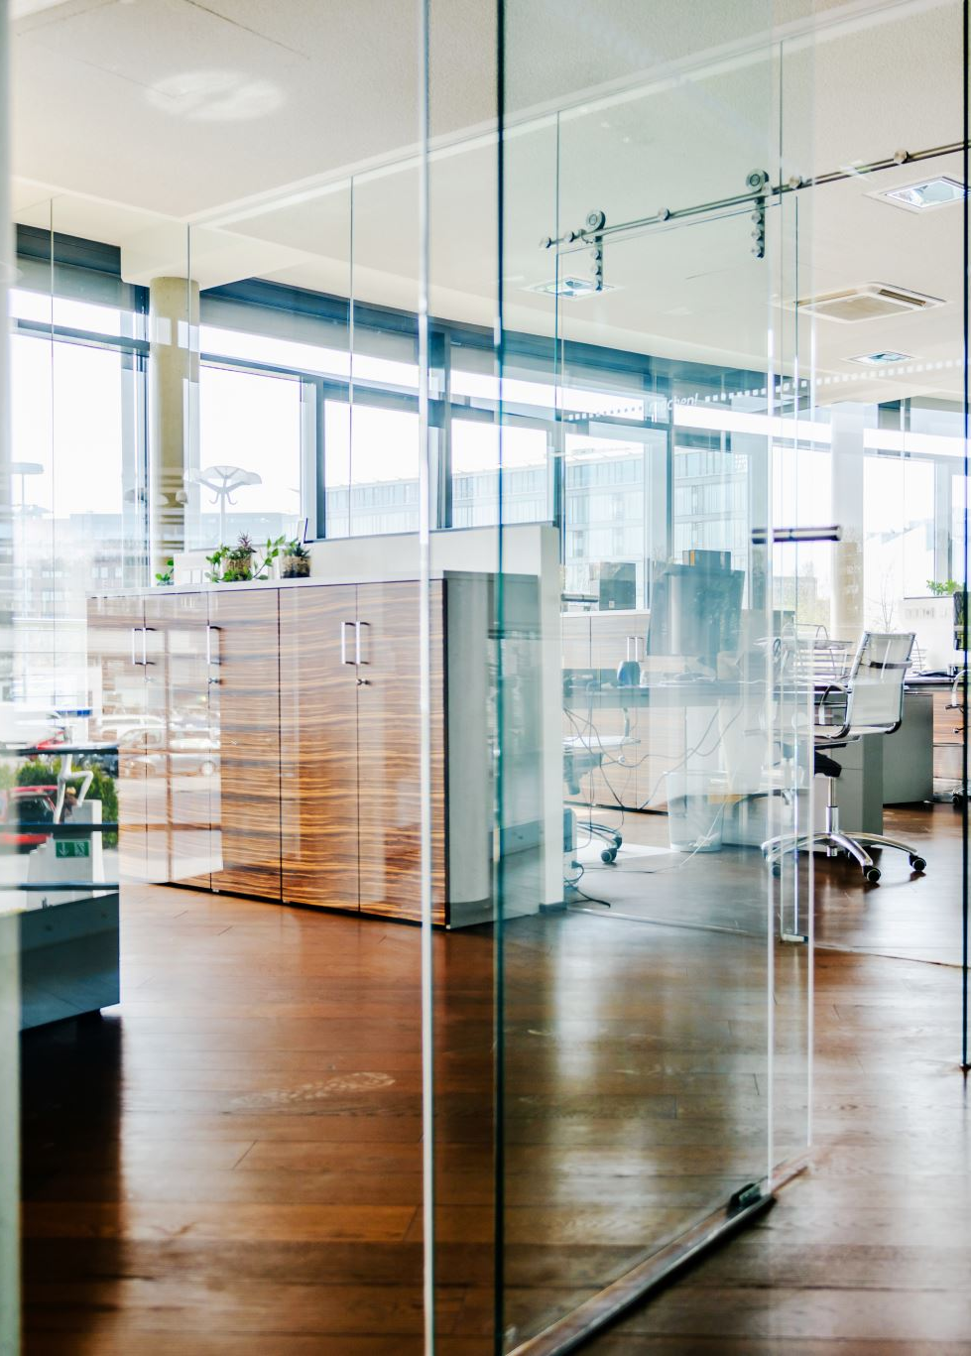
The Problem
Glass shops lose time & sales due to outdated, disconnected tools.
Current software is slow, hard to use, and leaves gaps in sales, production, and installation.
There’s no intelligent, connected, all-in-one solution built for glass shops.

Slide 3

The Solution
glassAI: An all-in-one AI system for glass shops
saleAI: Smart quoting + urgency detection
cueAI: Inventory predictions + supplier switching
oStat: Live production tracking + delay prediction
insAI: Install ETA based on weather, traffic, and team
kiAI: Kiosk + at-home pre-order with QR integration

Slide 4
Traction
I already pitched to a glass shop, which showed demand.
I have pre-production feedback from a real glass shop.

Slide 5
Market Size & Urgency
The global glass and glazing market is valued at over $150 billion.
90% of glass shops rely on outdated ERP systems.
AI adoption is rising rapidly across many industries, but the glass industry has been left behind.
We have a first-mover advantage thanks to having the first and only AI-powered all-in-one solution for glass shops.

Slide 6

Business Model
We plan to sell this using a Software-as-a-Service (SaaS) model.
Our pricing will change as we get software developers’ quotes.
We plan on using a cloud infrastructure, with enterprise licenses starting at $250,000.
For our cloud users, we’ll be implementing a monthly usage cap, with options for reloads starting at $10.
For users, their ROI ranges from 6 to 24 months, depending on the modules used and tier.

Slide 7
What We Need
We’re seeking from $250,000 up to $300,000 in seed capital for my startup.
Up to $100,000, depending on the development costs, will be used for R&D.
$50,000 will be used for quality control and quality assurance (QC/QA).
$75,000 will be used for marketing.
Up to $50,000 will be used for supporting the cloud systems (AWS, Google Cloud, etc)
We can negotiate up to 25% ownership.

Slide 8
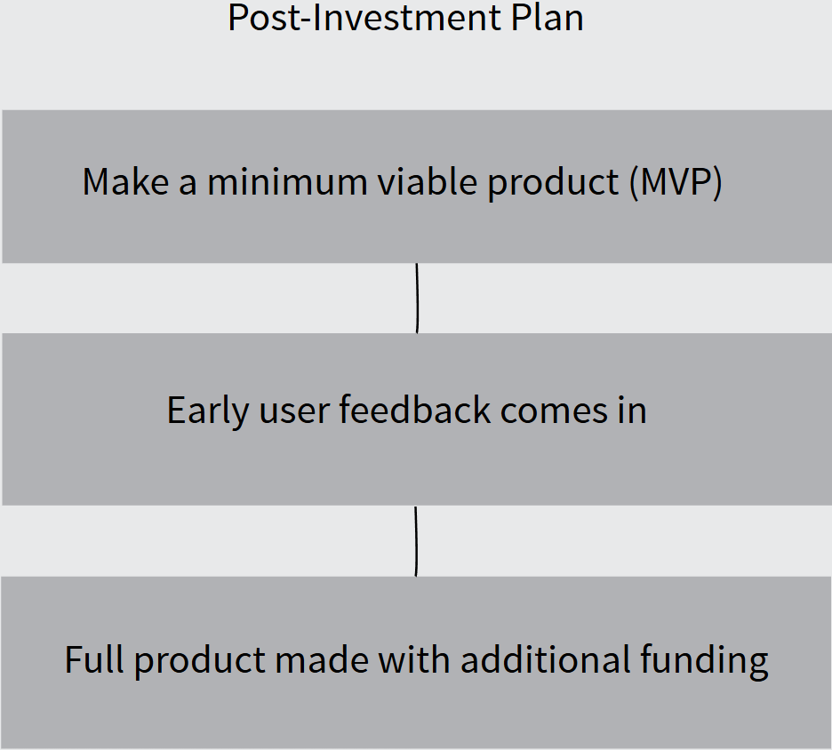
Our MVP Roadmap

Slide 9
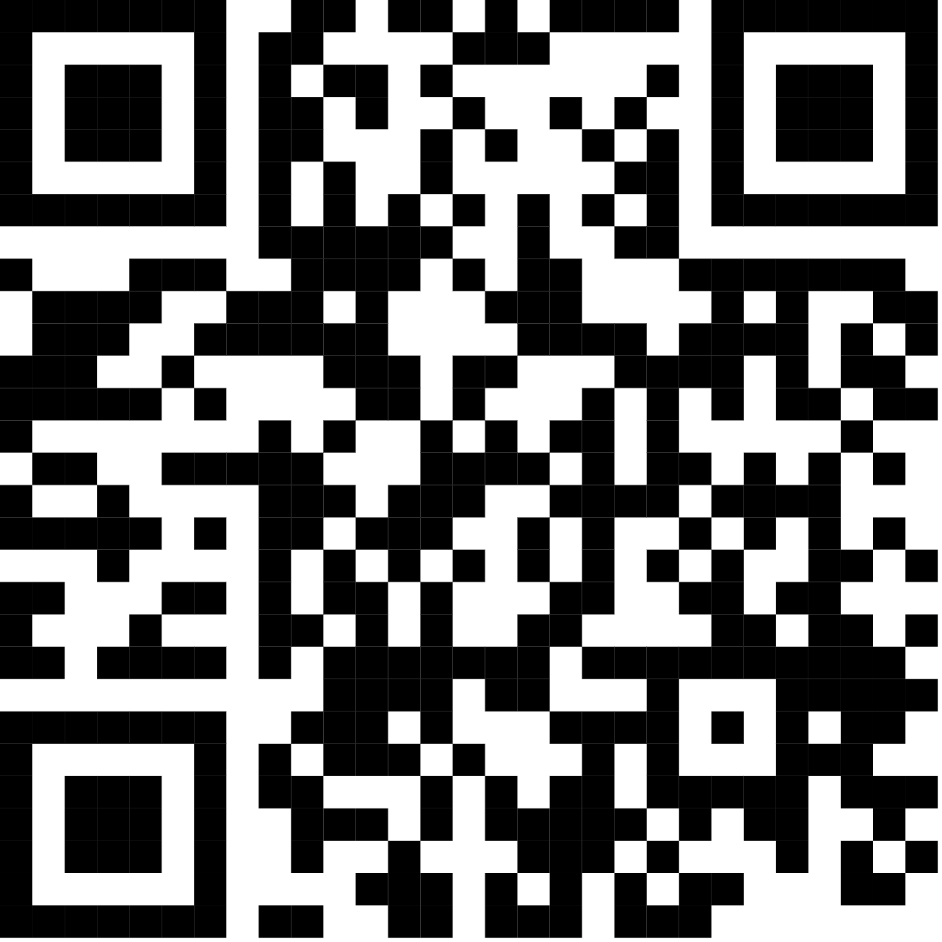
Thanks for listening!
Contact me at legobele@gmail.com for more information or to negotiate an investment.

